Slide 1
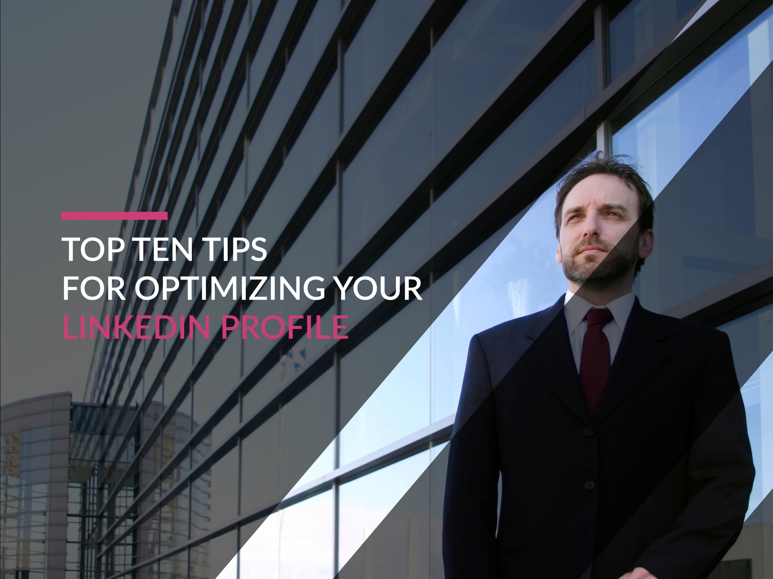

Slide 2
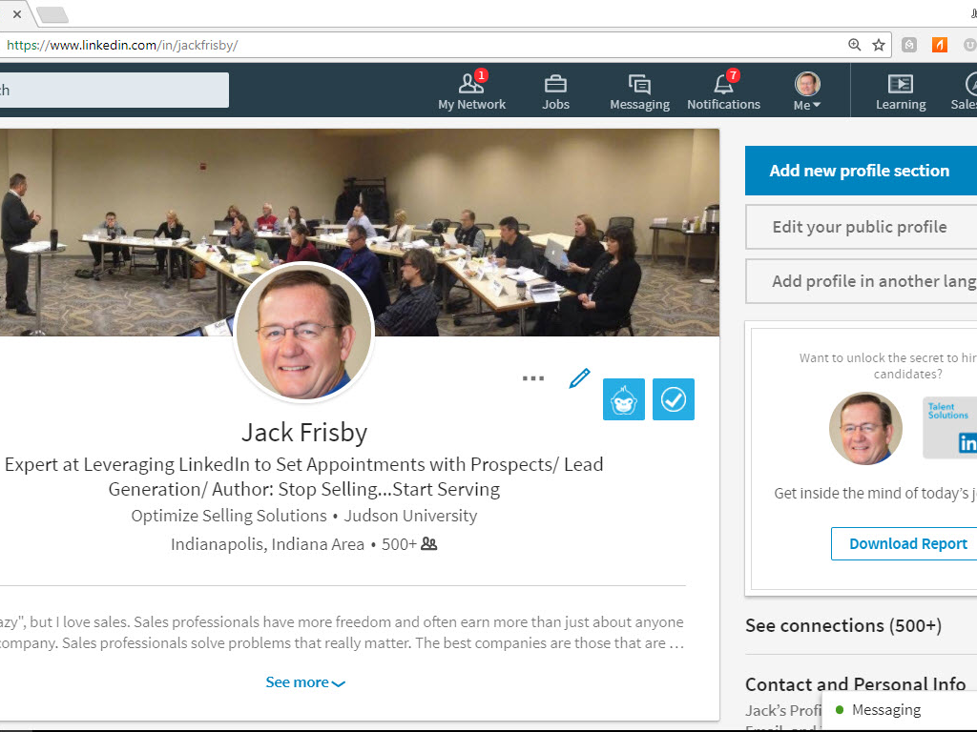
Your LinkedIn Profile is your Individual, Professional Website

Slide 3


Slide 4
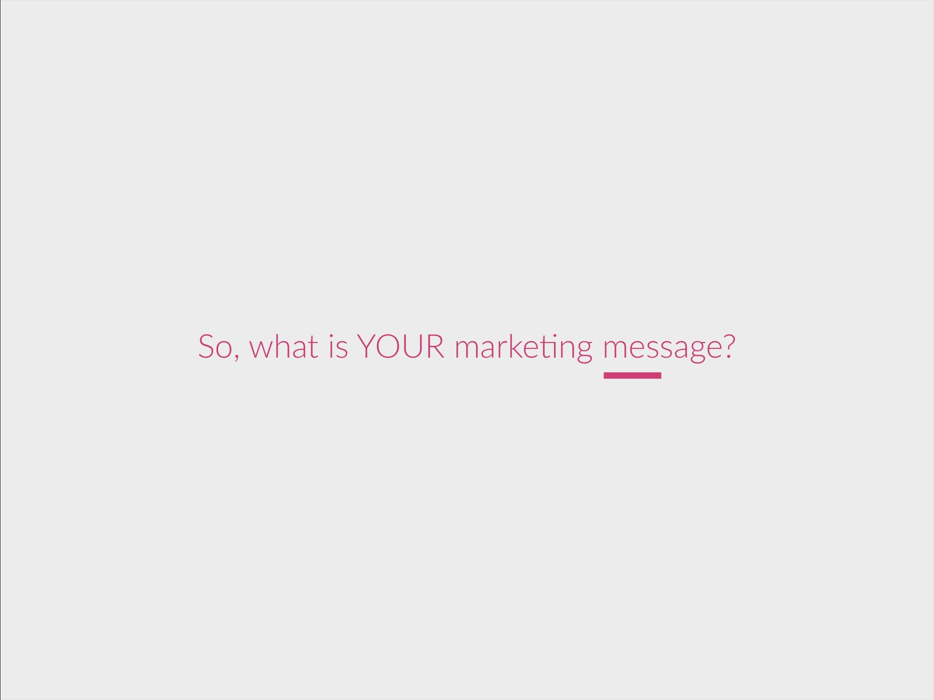

Slide 5


Slide 6


Slide 7


Slide 8


Slide 9
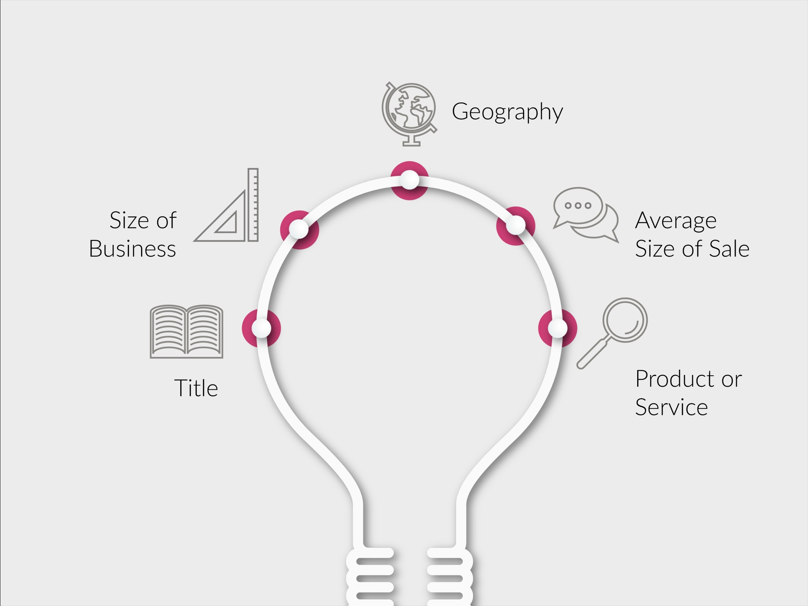

Slide 10


Slide 11


Slide 12
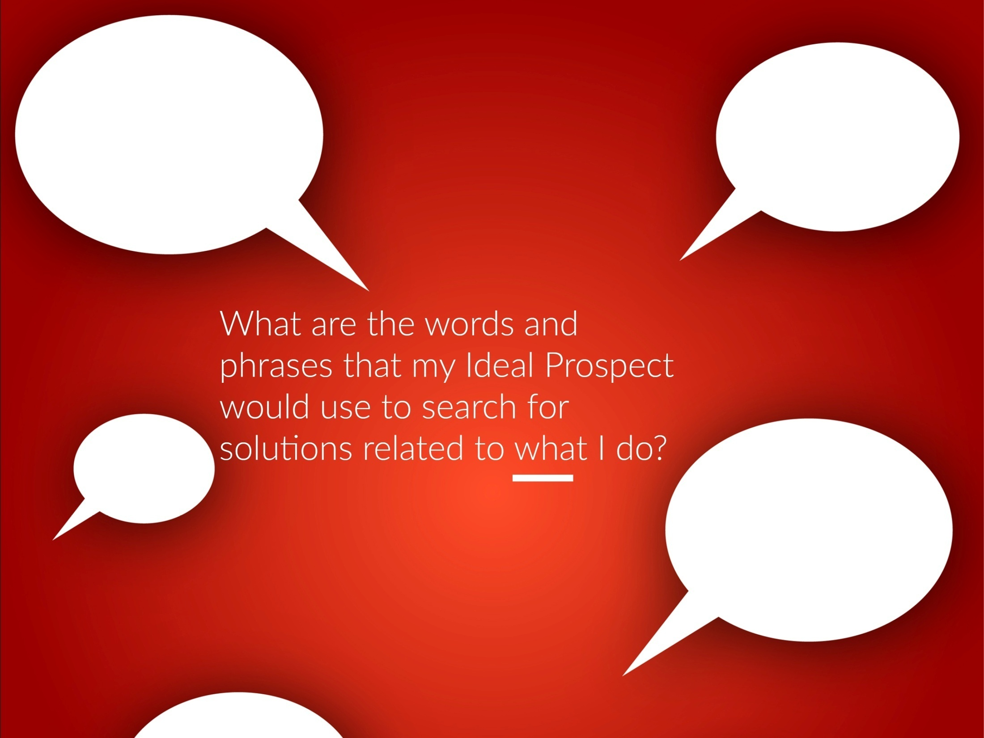

Slide 13


Slide 14


Slide 15


Slide 16
Time out: What are your top ten keywords & phrases?

Slide 17


Slide 18


Slide 19


Slide 20


Slide 21


Slide 22
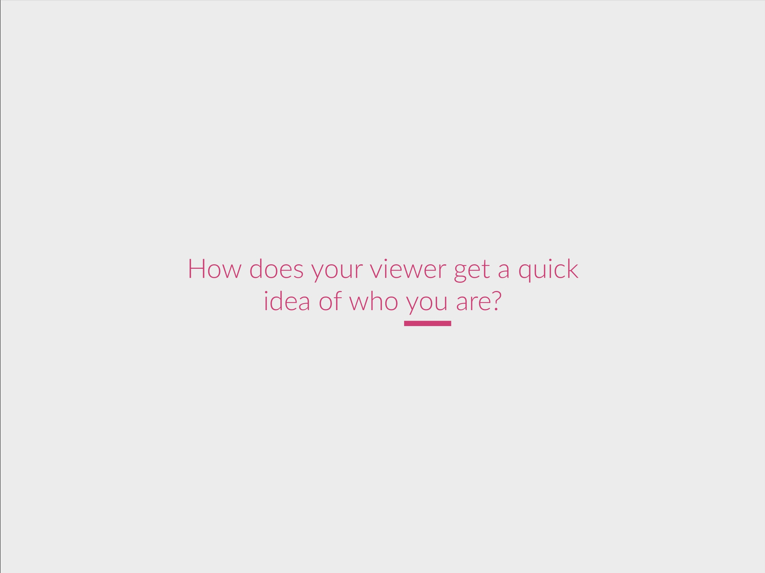

Slide 23
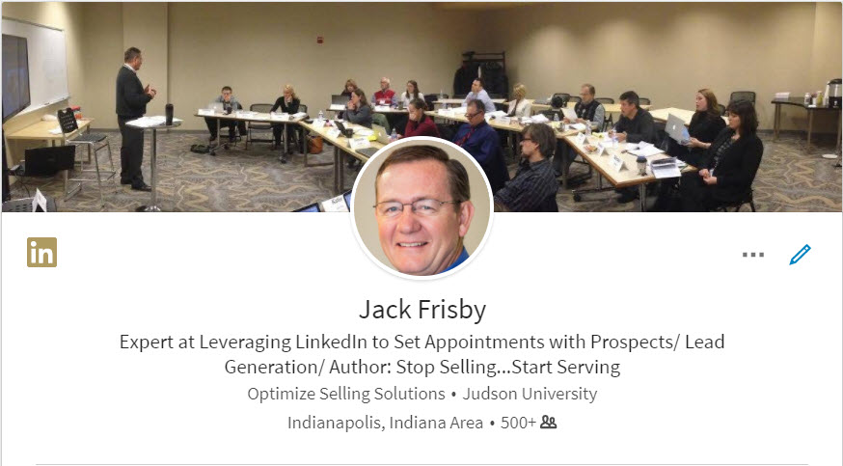

Slide 24
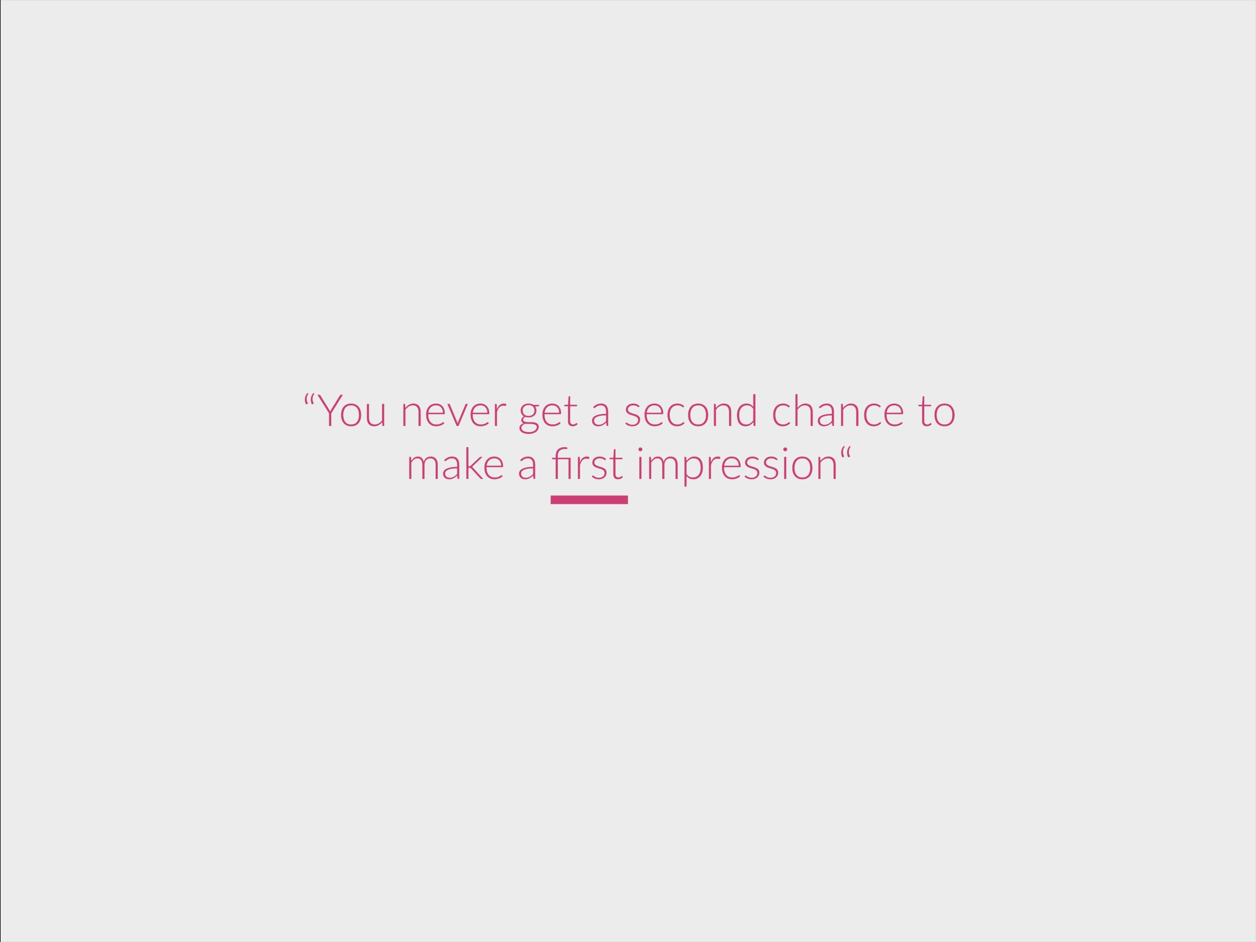

Slide 25


Slide 26
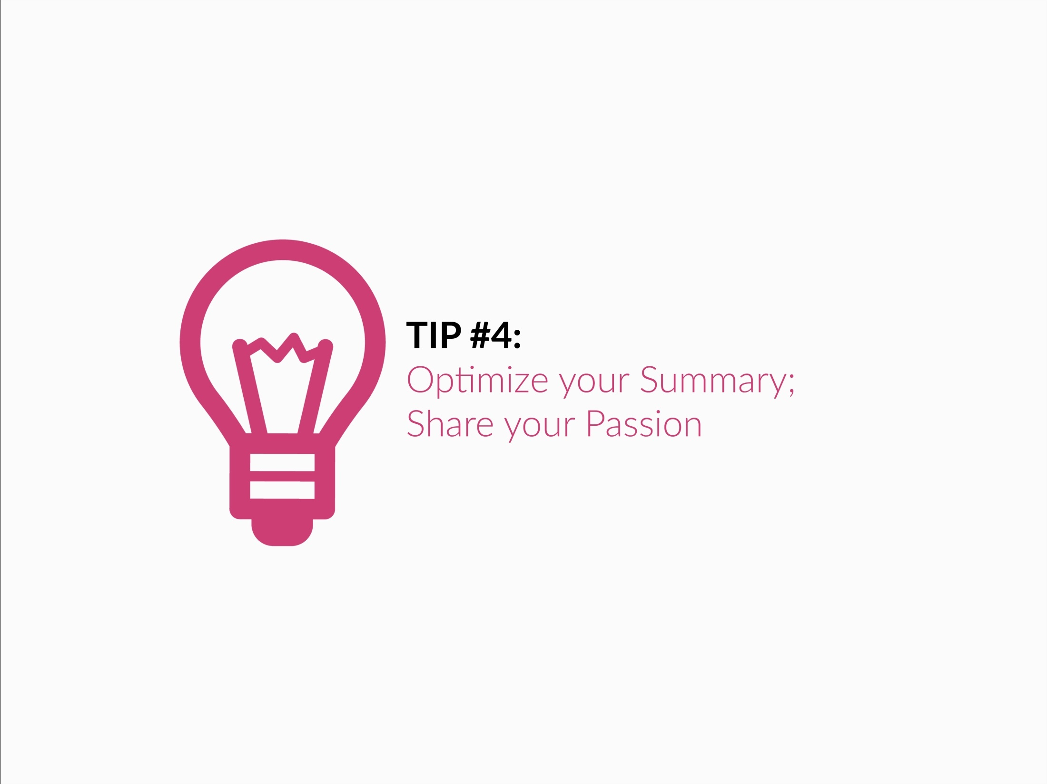

Slide 27


Slide 28


Slide 29


Slide 30
Time out: Summary 1. Why? 2. Why me? 3. Why now?

Slide 31
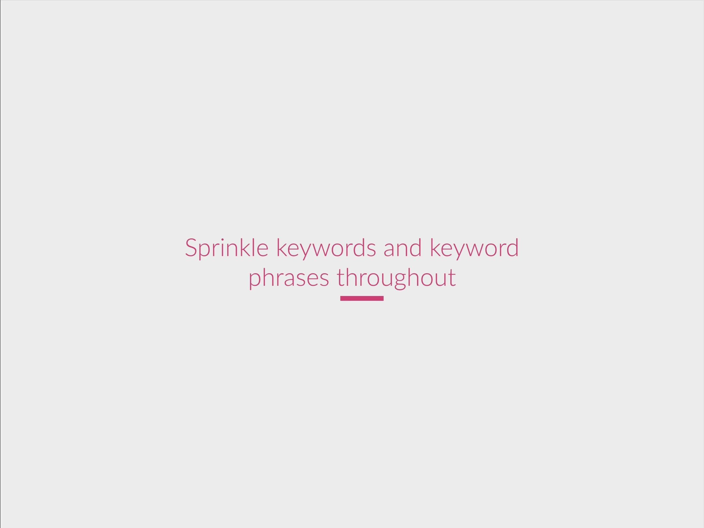

Slide 32


Slide 33


Slide 34
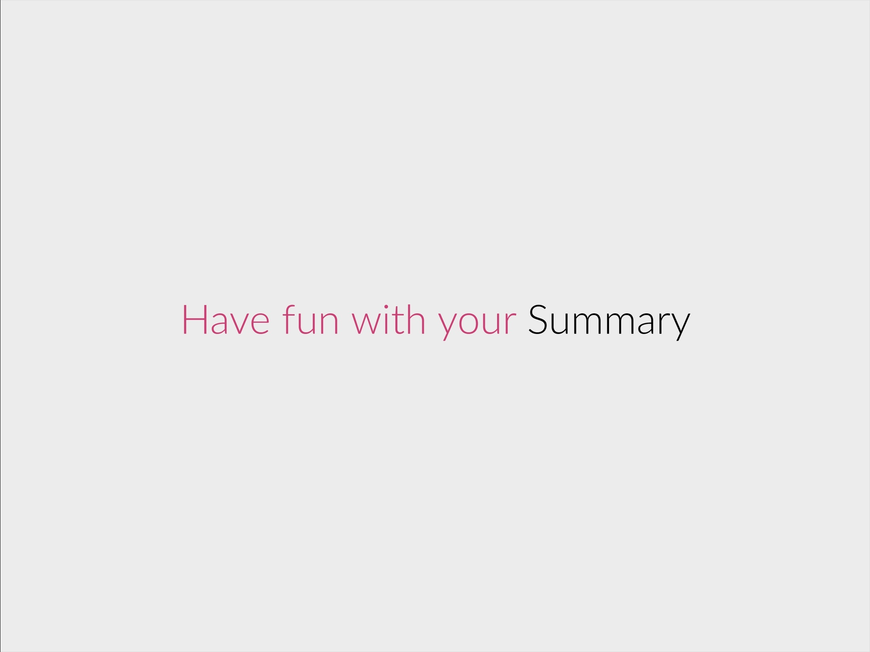

Slide 35


Slide 36


Slide 37


Slide 38
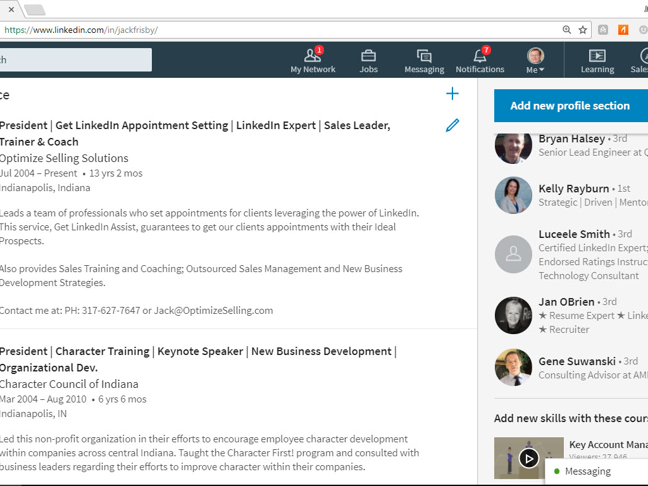
Go to your Experience Section

Slide 39
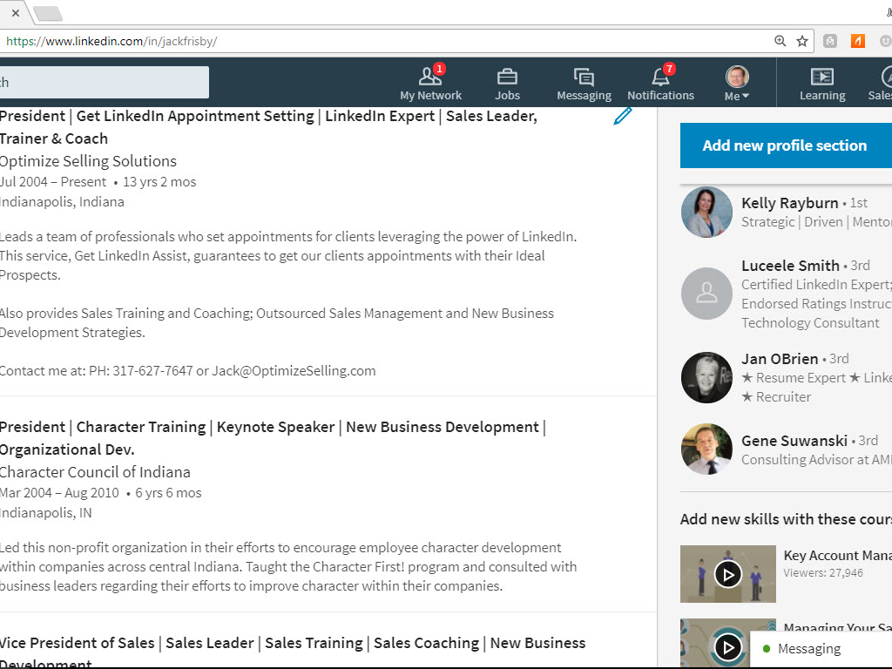
Add Search Terms to your Work Experience

Slide 40
Time out: Optimize your experience with keywords

Slide 41


Slide 42


Slide 43
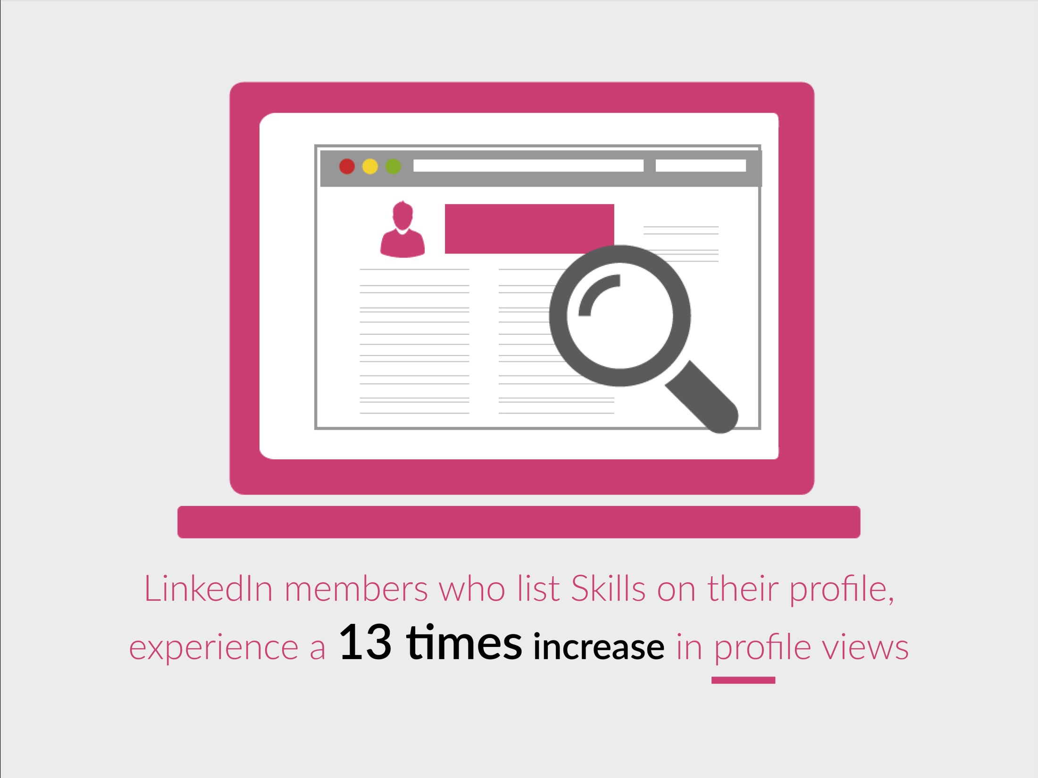

Slide 44


Slide 45
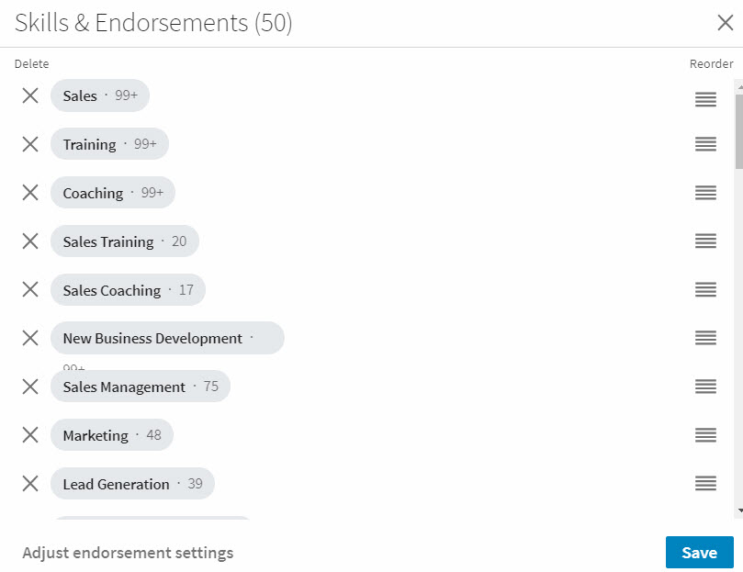
Place Top Ten Skills in the Order you want them to Appear

Slide 46
Time out: Optimize your skills with keywords

Slide 47


Slide 48


Slide 49
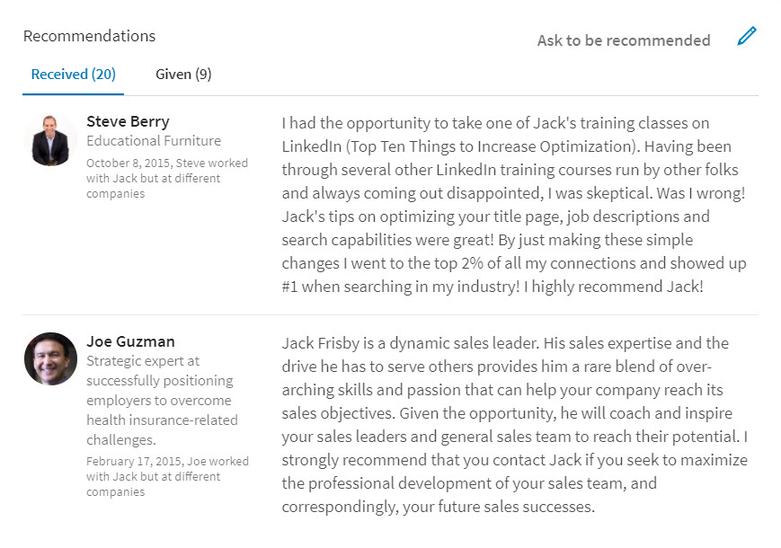
Average LinkedIn Member has just Two Recommendations;
Don’t be Average

Slide 50
Time out: from Whom do you want recommendations?

Slide 51


Slide 52


Slide 53
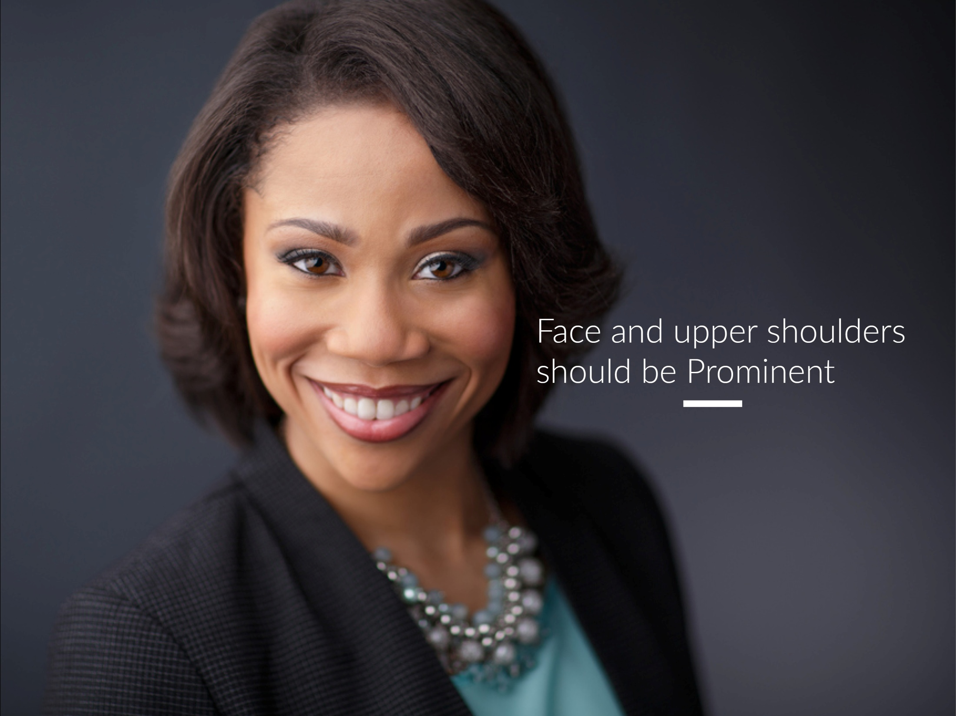

Slide 54


Slide 55


Slide 56
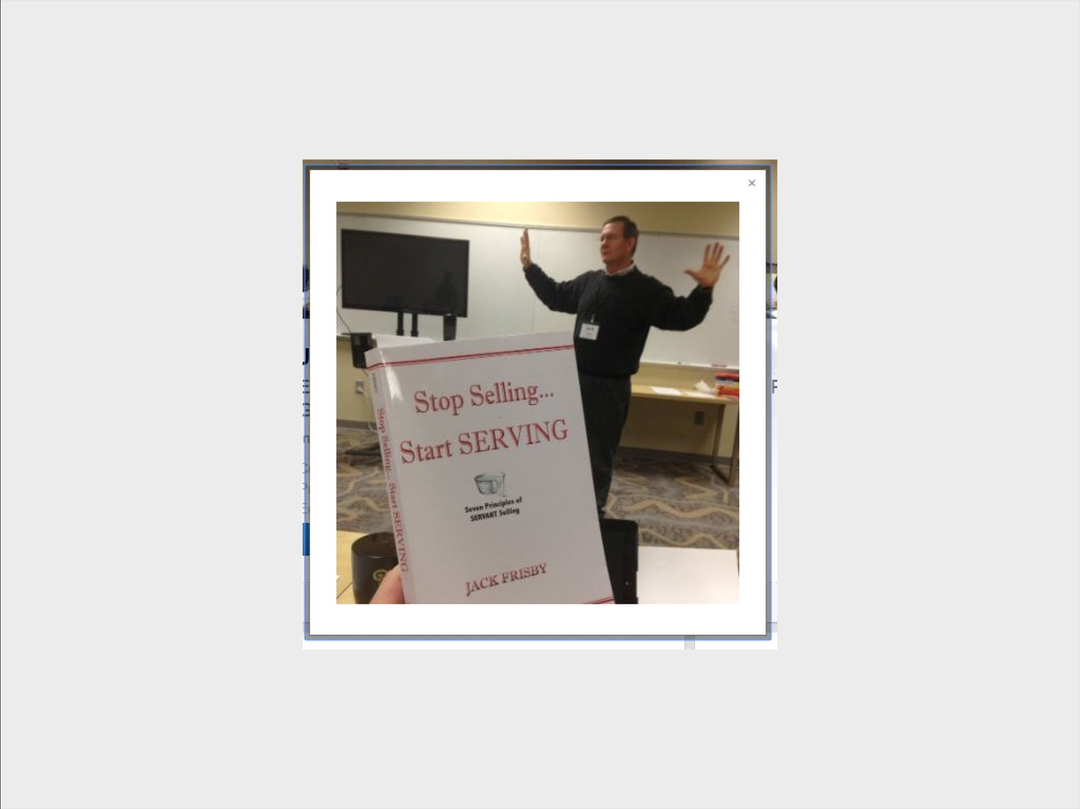

Slide 57


Slide 58


Slide 59
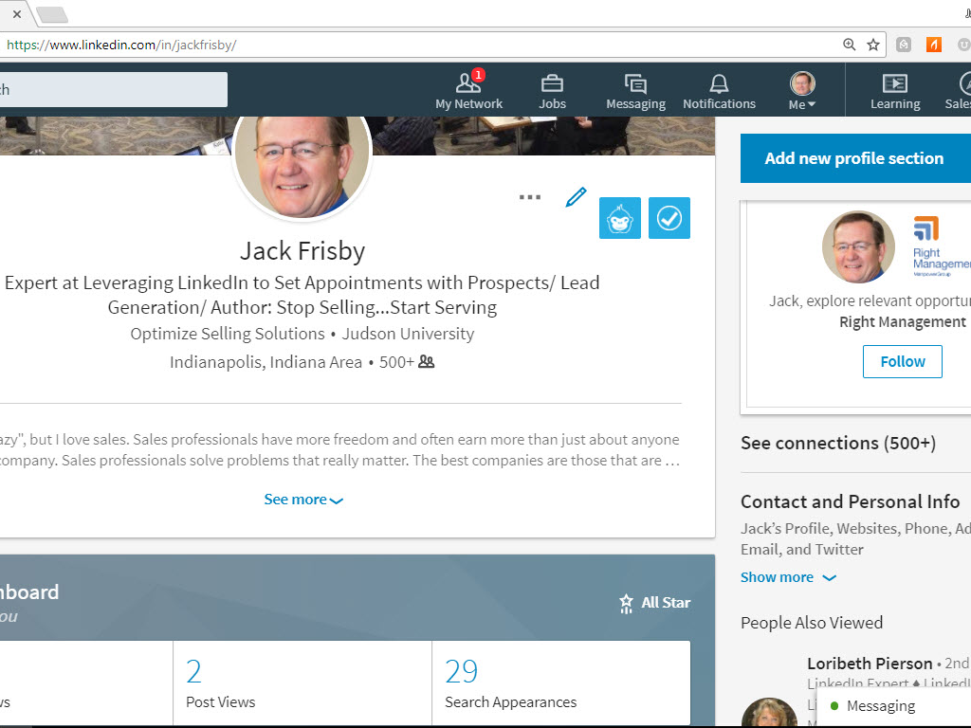
Contact Information

Slide 60
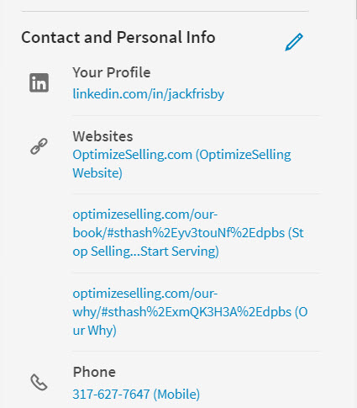

Slide 61


Slide 62
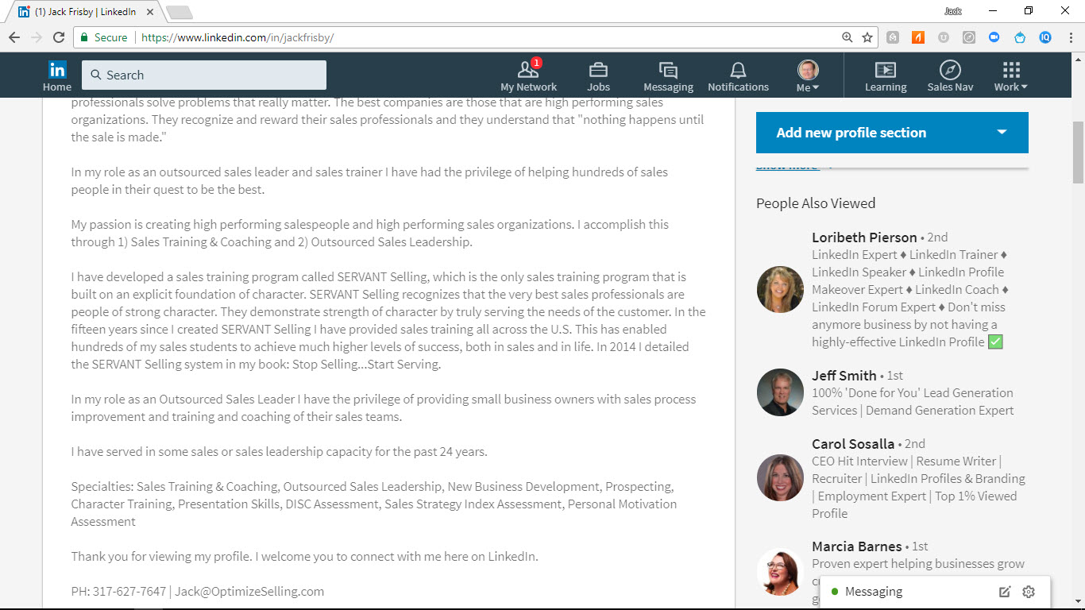

Slide 63


Slide 64


Slide 65


Slide 66


Slide 67
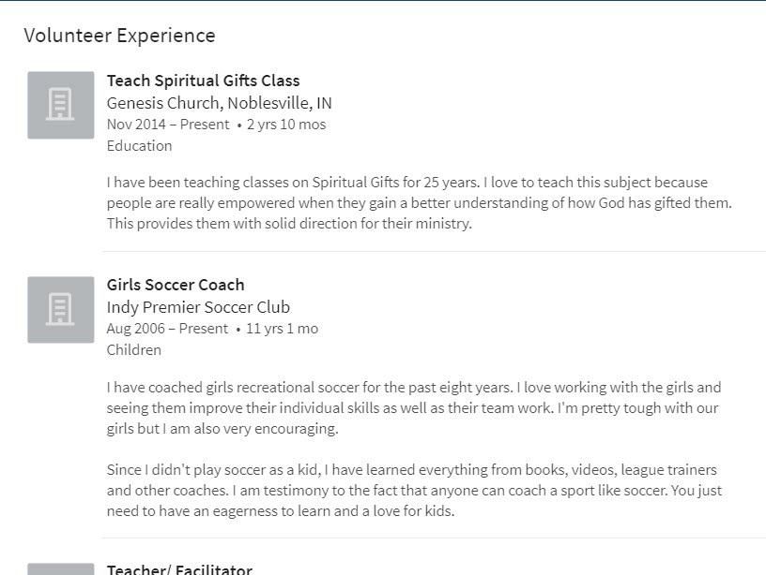
Someone visiting your LinkedIn Profile may be drawn to you through your Volunteer Experiences

Slide 68
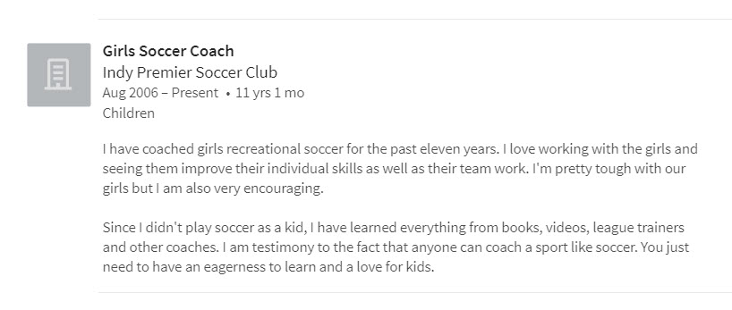
Example: Coaching Girl’s Soccer

Slide 69


Slide 70


Slide 71
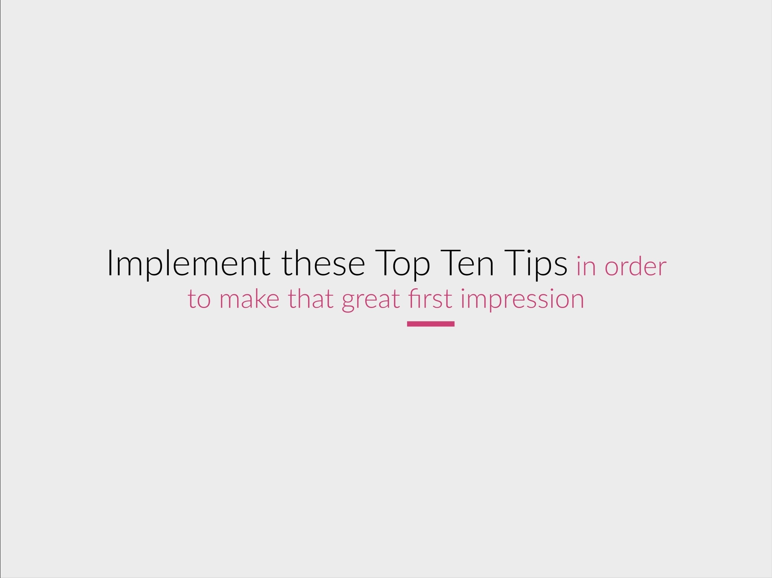

Slide 72
Time out: final discussion

